Slide 1
APOLOGETICS
IN ONE LESSON
almost
Ai1L.net

Slide 2
“Again, I observed this on the earth: The race is not always won by the swiftest, the battle is not always won by the strongest; prosperity does not always belong to those who are the wisest; wealth does not always belong to those who are the most discerning, nor does success always come to those with the most knowledge— for time and chance may overcome them all.”
Ecclesiastes 9:11 NET

Slide 3
“Objective consideration of contemporary phenomena compels the conclusion that success or failure in competitive activities exhibits no tendency to be commensurate with innate capacity, but that a considerate element of the unpredictable must invariably be taken into account.”
Ecclesiastes 9:11 (parody by Orwell in “Politics and the English Language”)

Slide 4
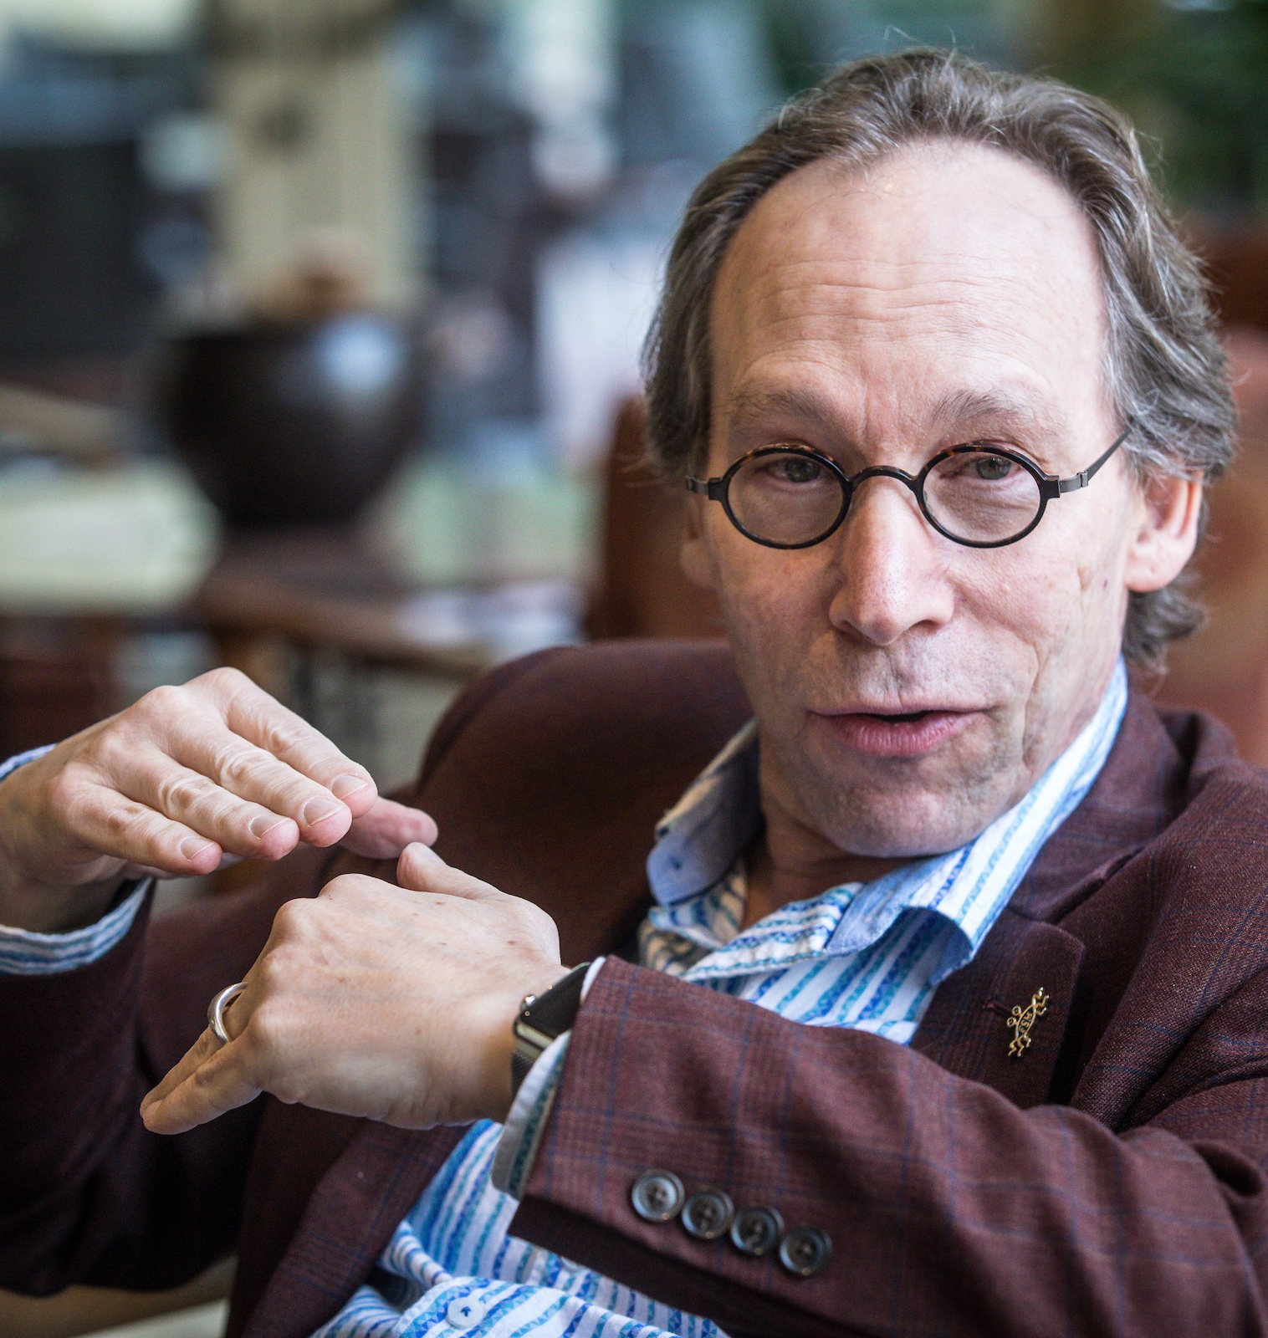
“Since ‘nothing’ is as simple as it gets, we cannot expect it to be very stable. It would likely undergo a spontaneous phase transition to something more complicated, like a universe containing matter. The transition of nothing-to-something is a natural one, not requiring any agent.”
LAWRENCE KRAUSS God: The Failed Hypothesis: How Science Shows That God Does Not Exist (page 133)

Slide 5
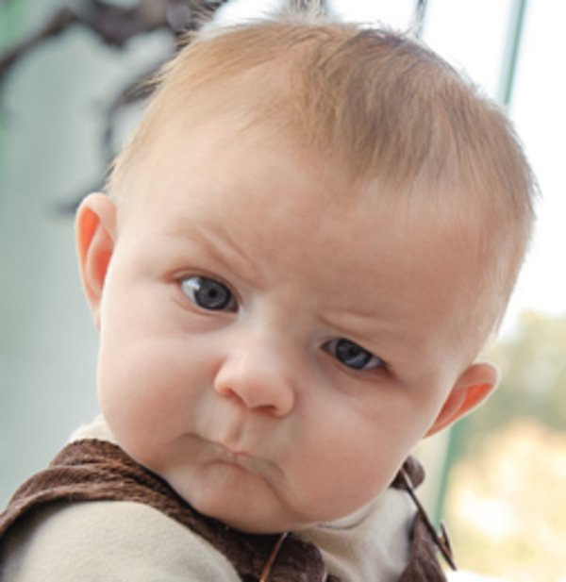
“’nothing’ is really simple, and since simple things naturally become more complicated without anyone doing anything, nothing could become a universe.”
Normal human transition of Lawrence Krauss

